Slide 1

CHURCH VITALITY SURVEY RESULTS 2024
Here are the results for the first annual FEB Central Church Vitality Survey of 2024

Slide 2

FEB CENTRAL CHURCH VITALITY SURVEY 2024
Section 1:
Church Vitality
Survey Data

Slide 3





DATA 1
Church Attendance
2023
2024
293
NUMBER OF CHURCHES
302
+3.1%
162
AVERAGE SIZE
167
100
MEDIAN SIZE
95
47,413
TOTAL WEEKLY ATTENDANCE
50,500
+6.5%
10,513
YOUTH &
CHILDREN
11,137
+5.9%

Slide 4
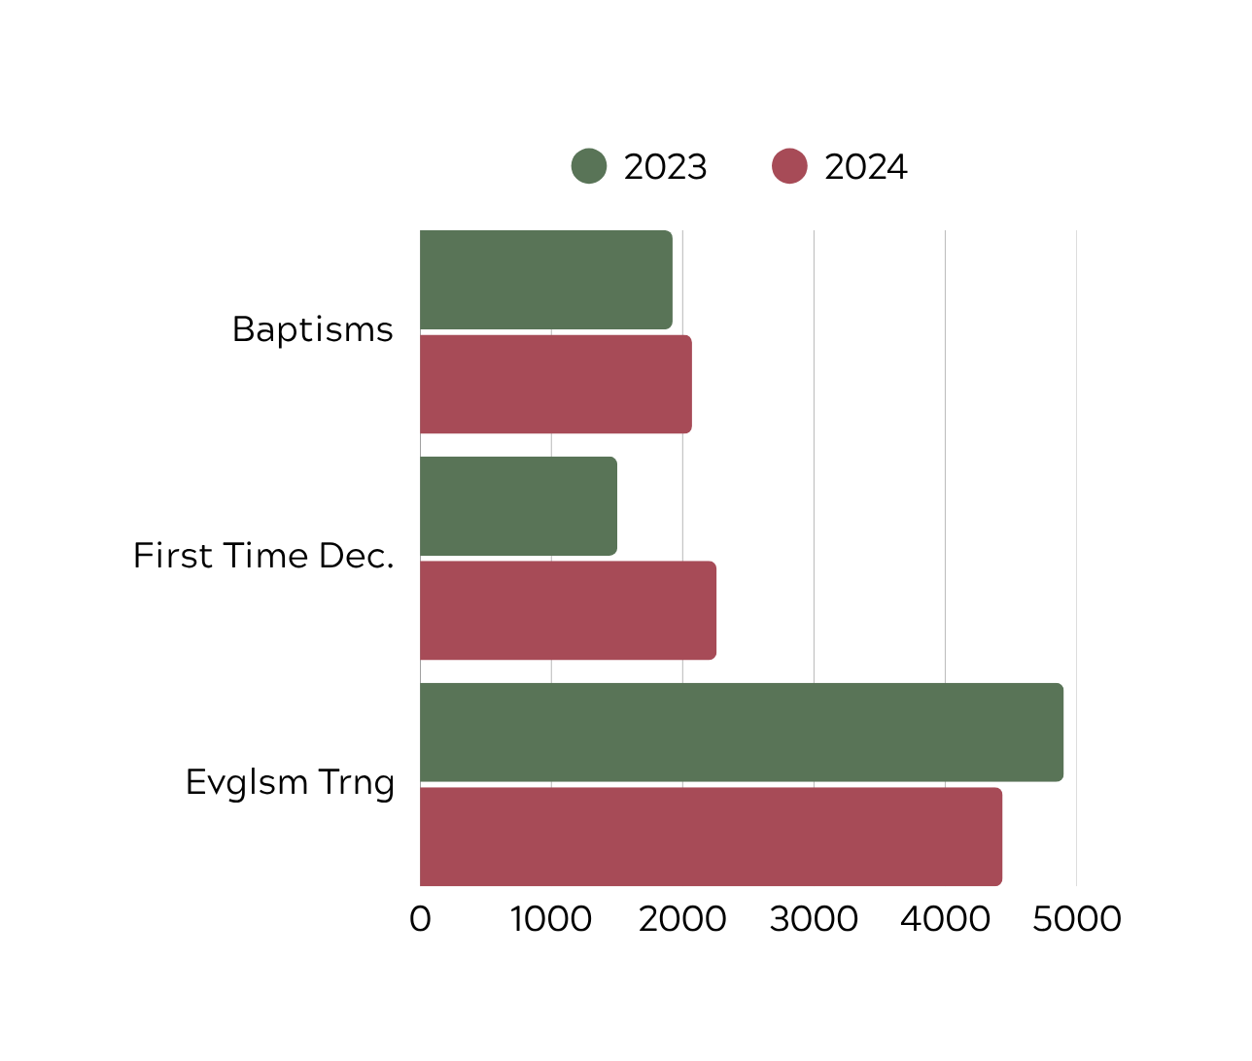

DATA 2
Evangelism
9%
2,071
1,923
Baptisms
+8%
2,071
First Time
Decisions
2,259
4.5%
4.1%
1,502
+50%*
Evangelism
Training
4,437
2,259
4,903
*Churches appear to be tracking first time decisions more closely in 2024, contributing to the increase.
-10%
4,437

Slide 5
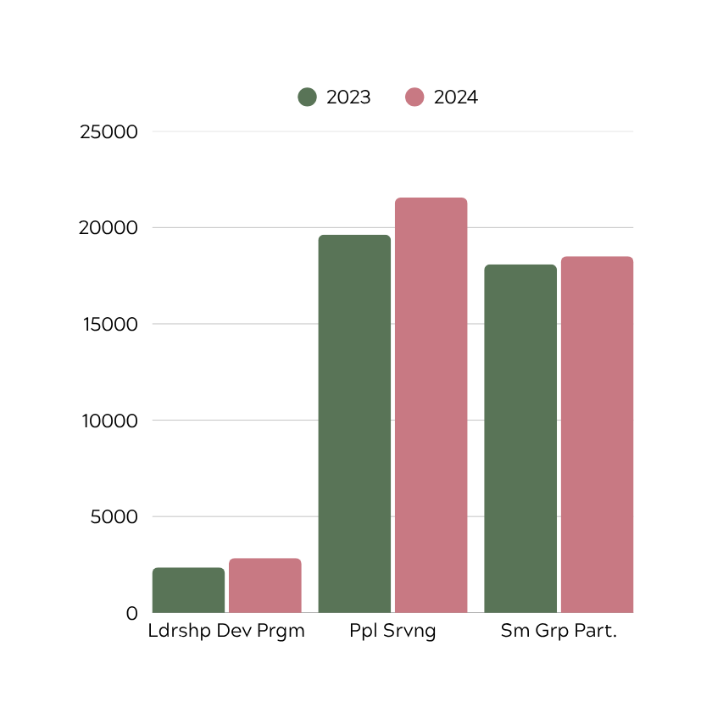

DATA 3
Discipleship
2023
140
CHURCHES WITH
152
2024
DISCIPLESHIP
PLAN
+9%
+10%
+2%
21,552
Leadership Dev Plan
2,845
19,631
18,093
+21%
18,504
21,552
People Serving
2,845
2,356
18,504
Sm Grp Participation

Slide 6


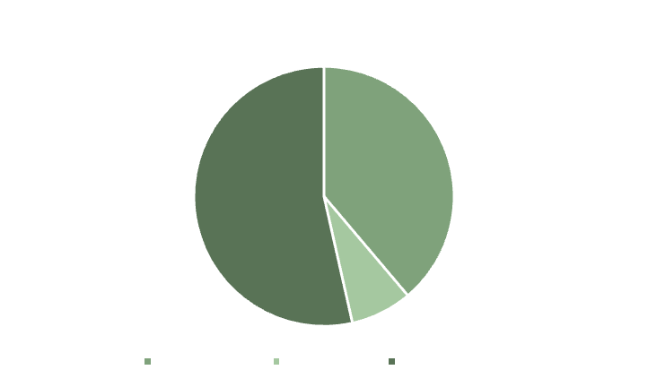

DATA 4
Church Planting
60
33
Active Plants
5
New Plants
34%
Desire to Plant
58%
No Desire or Plan
to Plant
Plants
Non-Plants
Baptism Rate
4.4%
4.1%
Evangelism Training
15%
8%
8%
Desire &
Plan to Plant
Discipleship Plan
72%
46%
Small Group Participation
47%
35%

Slide 7
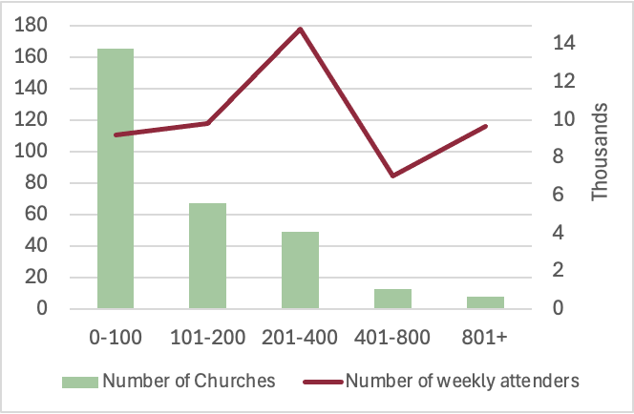
DATA 5
Churches by Size
14,580
~27%
2024
9,593
9,102
10,248
165
6,977
67
49
8
13

Slide 8
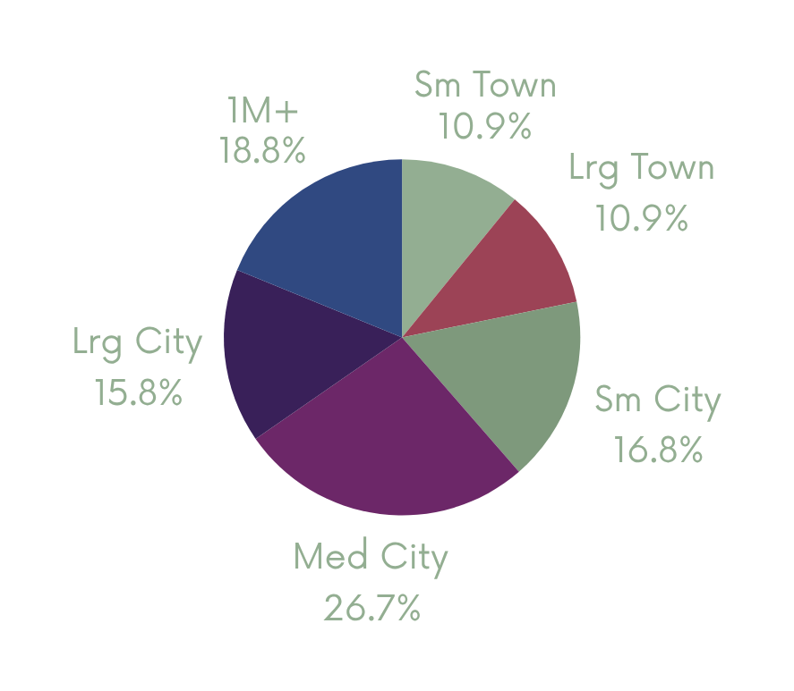



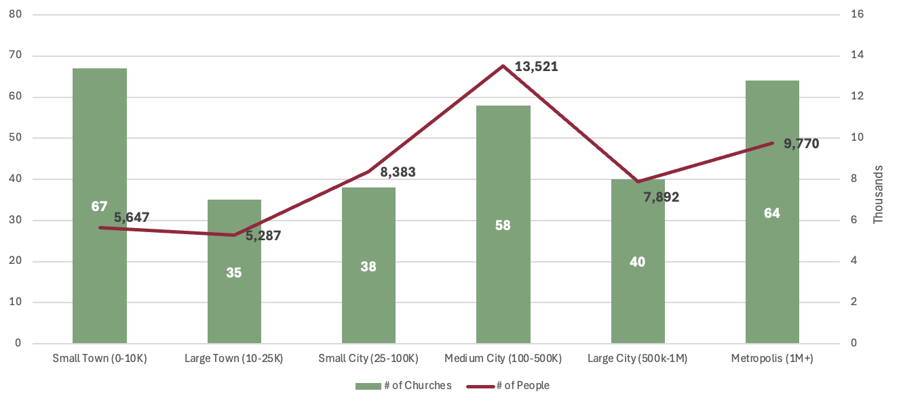
DATA 6
Churches by City Size
Small Town (0-10K)
Large Town (10-25K)
Small City (25-100K)
Medium City (100-500K)
Large City (500k-1M)
Metropolis (1M+)
2024
% of People

Slide 9



DATA 7
Income
2023
2024
Total Income:
Total Income:
$ 105,906,500
$ 109,502,184
3.4%
Avrg
Income/Attender:
Avrg
Income/Attender:
-2.9%
$ 2,234
$ 2,168

Slide 10
FEB CENTRAL CHURCH VITALITY SURVEY 2024
Section 2:
Consultation Data
600 people surveyed in 8 church consultations

Slide 11



DATA 8
Demographics (600 people, 8 churches)
CHURCH
AVERAGES
REGIONAL AVERAGES
BACHELORS DEGREE OR HIGHER
70%
19%
Men
37%
VISIBLE MINORITIES
10.5%
10.2%
Women
63%
MARRIED
75%
56%
SINGLE
11%
25%
Average Age Attending (15+)
Churches
51
Canada
47

Slide 12
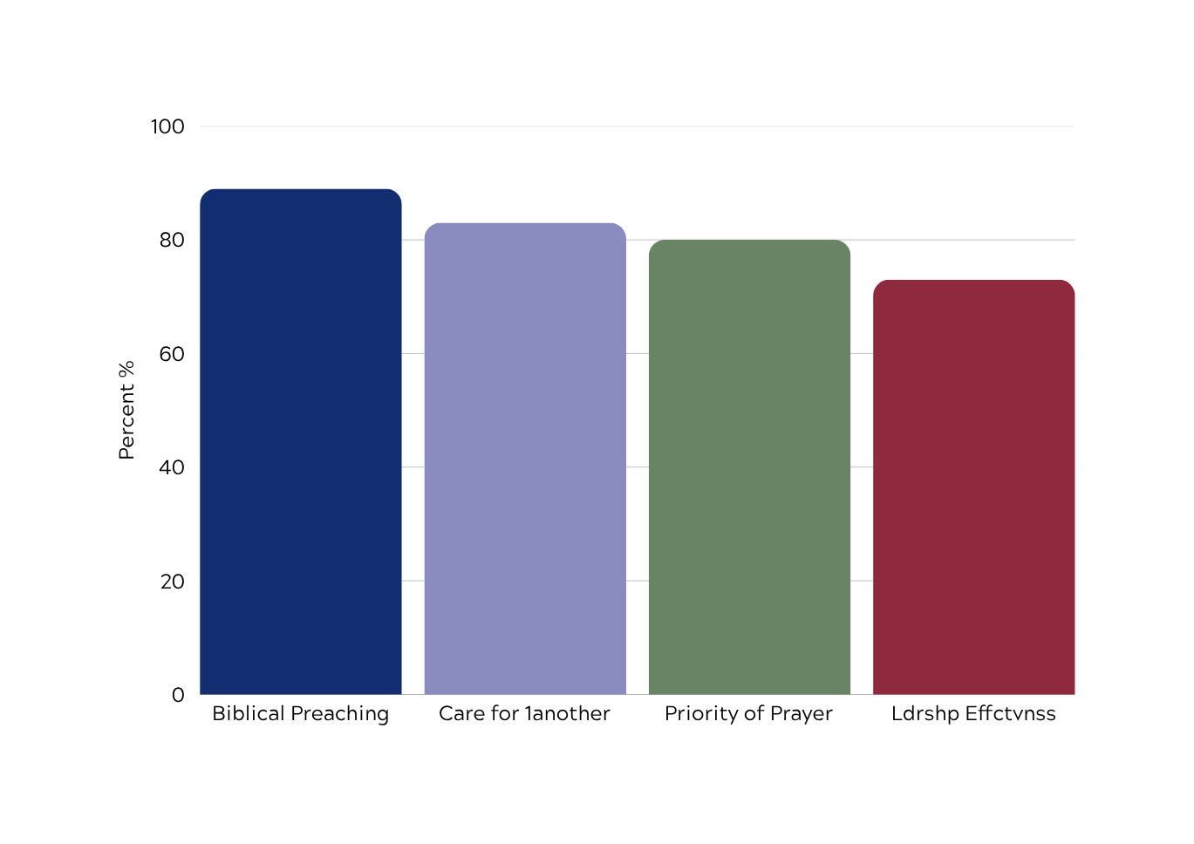
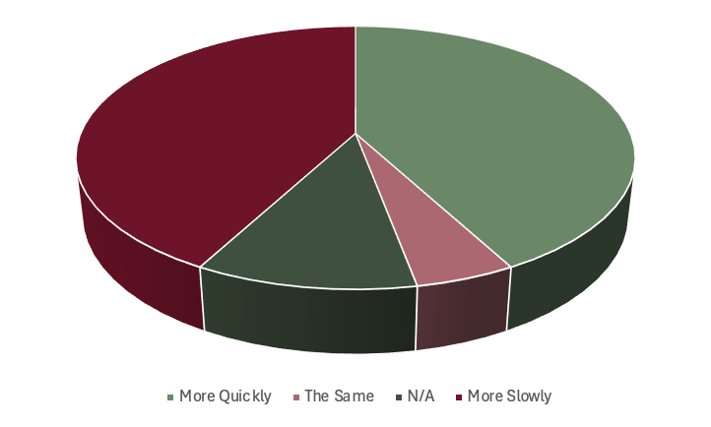
DATA 9
Church Vitality (600 people, 8 churches)
“Since attending this church,
my spiritual life has grown...”
The pastor communicates God's Word in a clear and effective way.
The people in the chuch feel that it is a caring place.
Prayer is a foundation of our church life and ministry.
The leaders have clear goals and seem to be effective in accomplishing them.
More Quickly
43%
The Same
43%
First Church
Attended
9%
More Slowly
5%
89
83
80
73

Slide 13
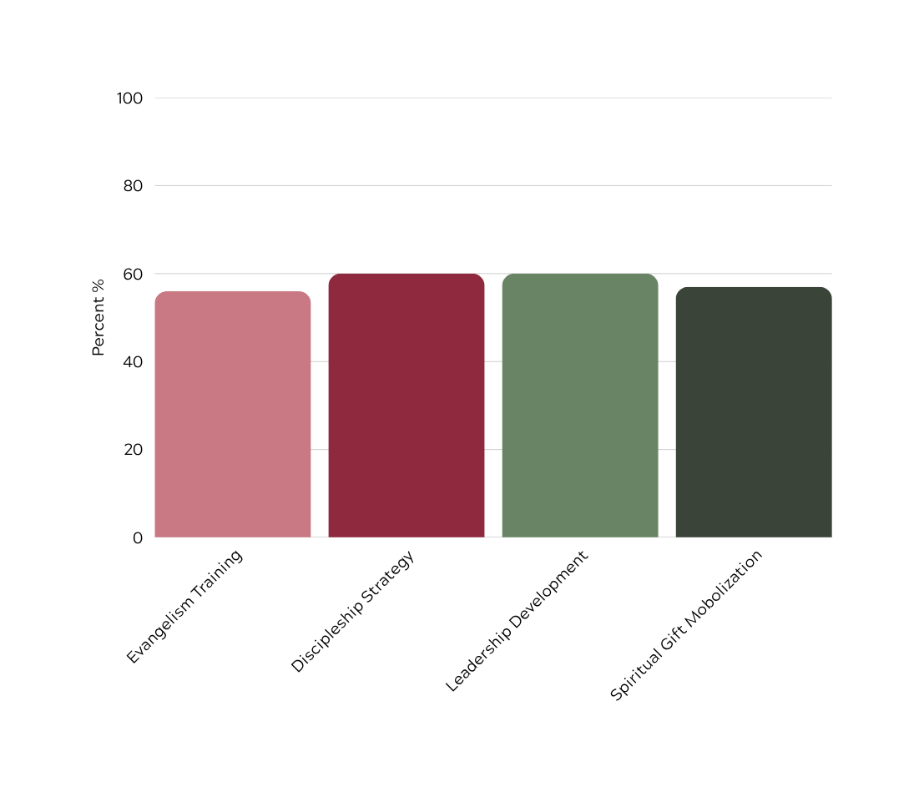

DATA 10
Church Vitality (600 people, 8 churches)
67%
LOCAL
CHURCH
CHURCH &
MINISTRIES
57
60
INDIVIDUAL GIVING
6.7%
8.2%
56%
Our church has an effective program
for training people in evangelism
We have a discipleship/
mentoring program that is important to our church.
There is a process for developing new leaders in our church.
Clear pathway to discover my spiritual gifts and use them in ministry.
60
56
60
60
57

Slide 14
NOTES
Survey Notes
Section 1: Church Vitality Survey Data
227 (75%) churches completed the survey, representing 87% of church attenders
75 (25%) churches did not complete the survey, representing 13% of church attenders.
When data was unavailable, reasonable estimates were made.
Survey conducted in spring 2025.
Section 2: Consultation Data
600 people surveyed in 8 church consultations
* Any questions can be sent to blair@febcentral.ca *
Data assembled by Tim Strickland. Designed by Blair Hicks.

